Slide 1
MILESTONE 1 · GROUP 5
ID Card Processing (ICP) Pipeline
An end-to-end OCR pipeline for Chinese national ID cards: implemented, evaluated, and scaled to 20,000 images.
ISHAN PATHAK · NIZAR TALTY
Designing End-to-End ML Systems · Prof. Tanu Malik · University of Missouri · October 7, 2026

Slide 2
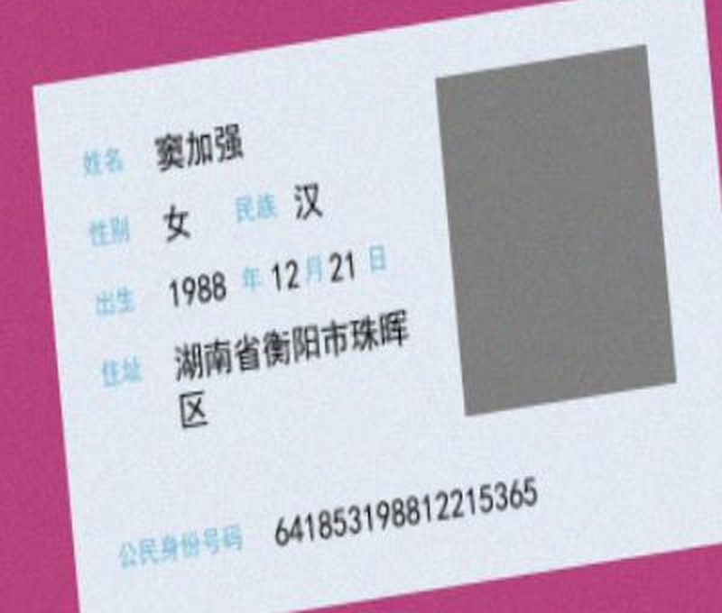
ID CARD PROCESSING (ICP) PIPELINE · MILESTONE 1
An end-to-end OCR pipeline for Chinese ID cards
Label | Text
The task | Extract the 8 annotated fields of a Chinese ID card image as text.
This milestone | Build a working end-to-end pipeline and compare different ways of processing the images.
What we focus on | Whether each configuration runs successfully, how accurately it extracts the annotated fields, and how long it takes.
Input: one card image
Field | Annotated text
Name | 窦加强
Gender | 女
Ethnicity | 汉
Birth year | 1988
Birth month | 12
Birth day | 21
Address | 湖南省衡阳市珠晖区
ID number | 641853198812215365
Challenges
Chinese text | The are 10s of thousands of characters. The OCR system must recognize them.
Small characters | Each field is printed small on a 500 × 500 image.
Degraded image quality | Cards are rotated, blurred, and set on colored backgrounds.
OUTPUT: 8 STRUCTURED FIELDS

Slide 3
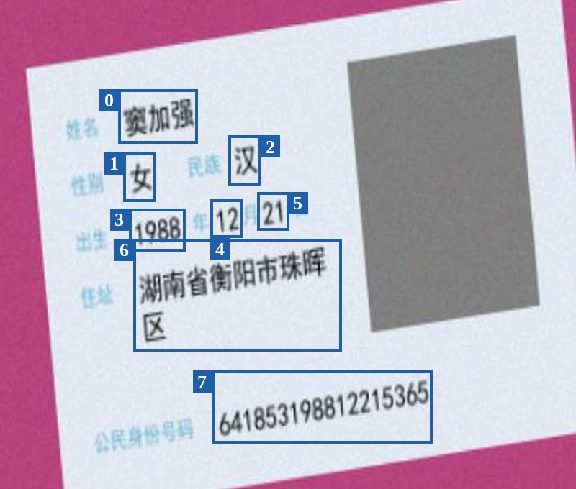

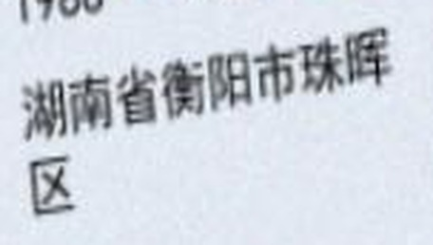
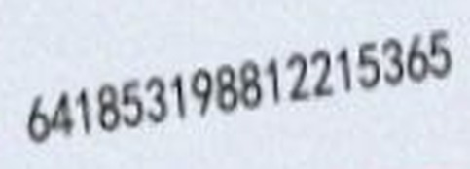
ID CARD PROCESSING (ICP) PIPELINE · MILESTONE 1
Optical Character Recognition (OCR)
OCR converts text in an image into machine-readable text. For an ID card, the useful output includes both the text and its location on the card
STEP 1: TEXT DETECTION
CROPPED REGIONS
STEP 2 : TEXT RECOGNITION
Read the characters inside each box.
Region | Annotated text
Name | 窦加强
Address | 湖南省衡阳市珠晖区
ID number | 641853198812215365
Locate each piece of text with a bounding box
Each box is cut out and passed to the recognizer
Each detection has a confidence value between 0 and 1.
We represent each detection by its text, box, and confidence value

Slide 4
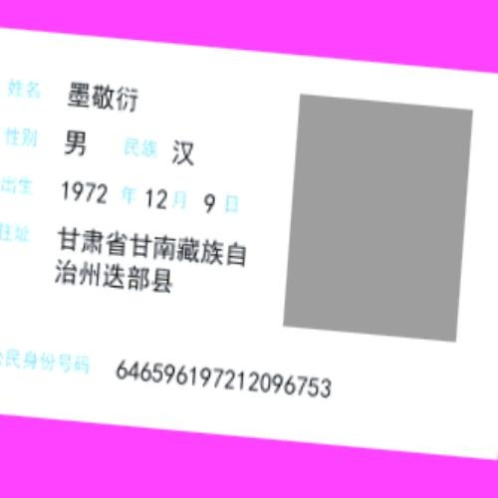
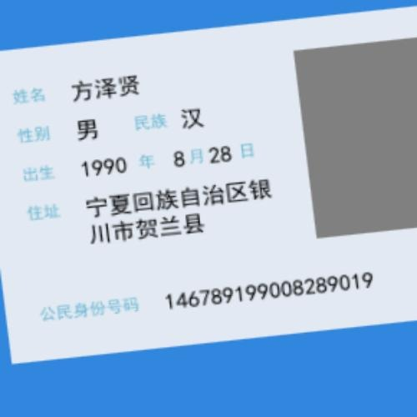
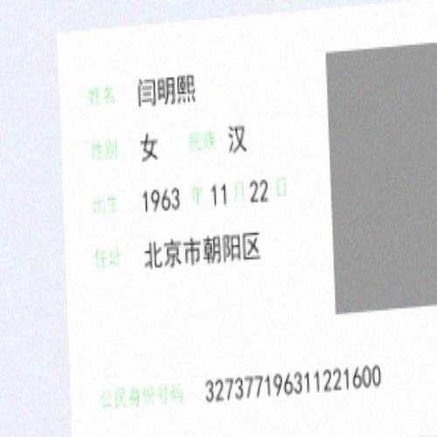
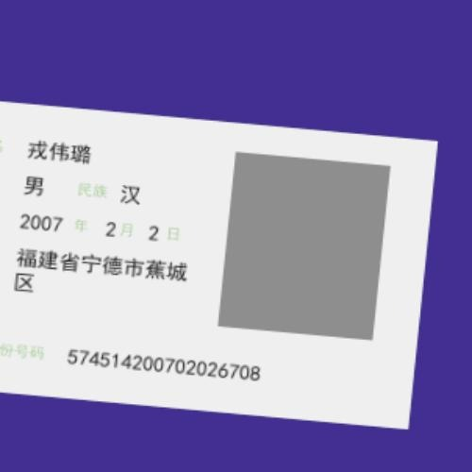
ID CARD PROCESSING (ICP) PIPELINE · MILESTONE 1
Dataset
We use the lansinuote/ocr_id_card dataset, which contains 20,000 Chinese ID card images
Annotations on one card
Class | Field | Annotated text | Type of text
0 | Name | 窦加强 | Chinese characters
1 | Gender | 女 | One character
2 | Ethnicity | 汉 | Chinese characters
3 | Birth year | 1988 | 4 digits
4 | Birth month | 12 | 1 or 2 digits
5 | Birth day | 21 | 1 or 2 digits
6 | Address | 湖南省衡阳市珠晖区 | Long, wraps across lines
7 | ID number | 641853198812215365 | 18 digits
Each example contains an image and annotations for its 8 fields.
An annotation gives the class, the bounding box, and the text of a field
Size: 20,000 images × 8 fields = 160,000 annotated fields per configuration.
Format: 500 × 500-pixel color images, synthetic.
Variety: background color, rotation, and blur differ between cards.
Four examples from the training split.

Slide 5
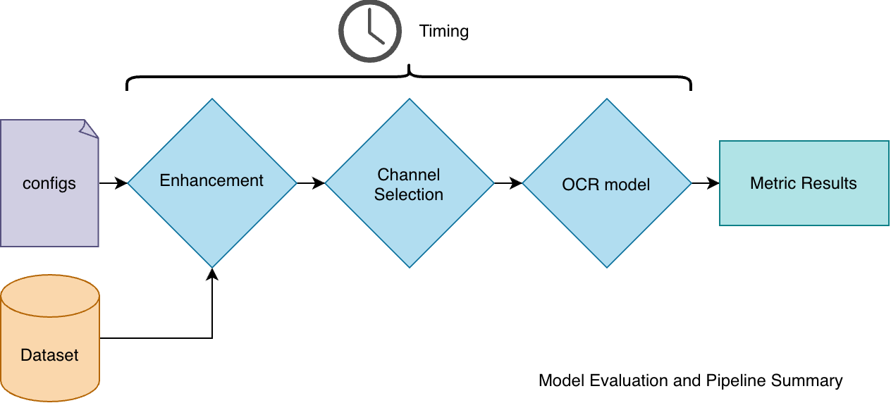
ID CARD PROCESSING (ICP) PIPELINE · MILESTONE 1
3 stage pipeline architecture with transportable components
Figure 1: ICP summary, The pipeline starts with loading the configurations that sets the pipeline steps. An input
image then passes through image enhancement, channel selection, and OCR before its output is evaluated against the annotated fields.
ONE CONFIGURATION
One choice at each stage, stored as a JSON entry.
File | What it does
image.py | Stages 1 and 2
ocr.py | Stage 3
metrics.py | Scoring
ICP.ipynb | Runs every configuration
{
"name": "contrast_red_green_easyocr",
"enhancement": [{"type": "contrast", "factor": 1.2}],
"channels": ["red", "green"],
"ocr": "easyocr"
}

Slide 6
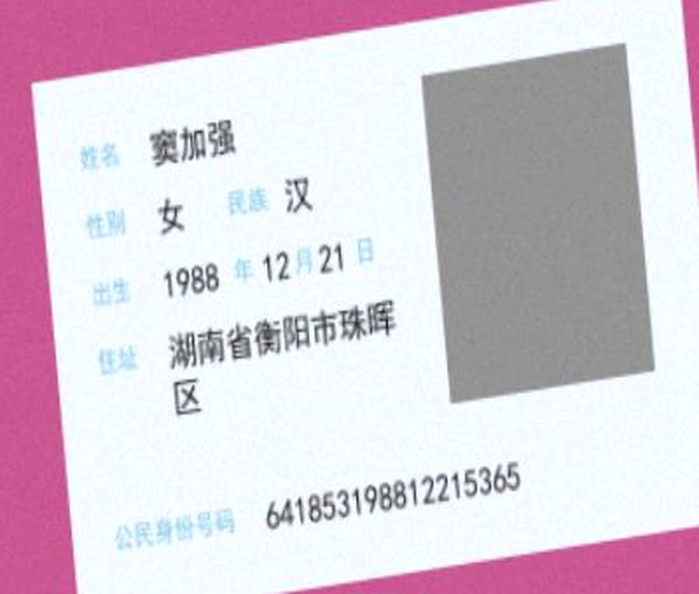
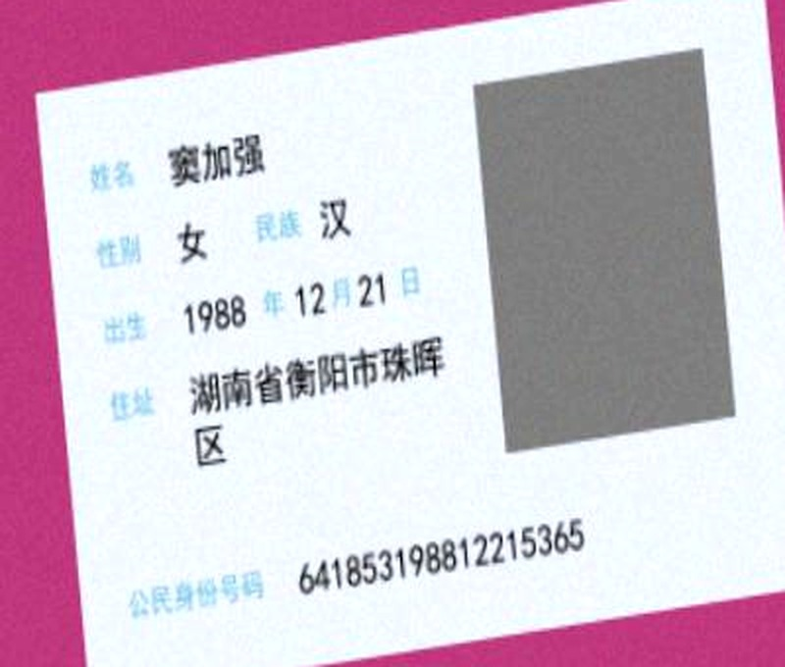
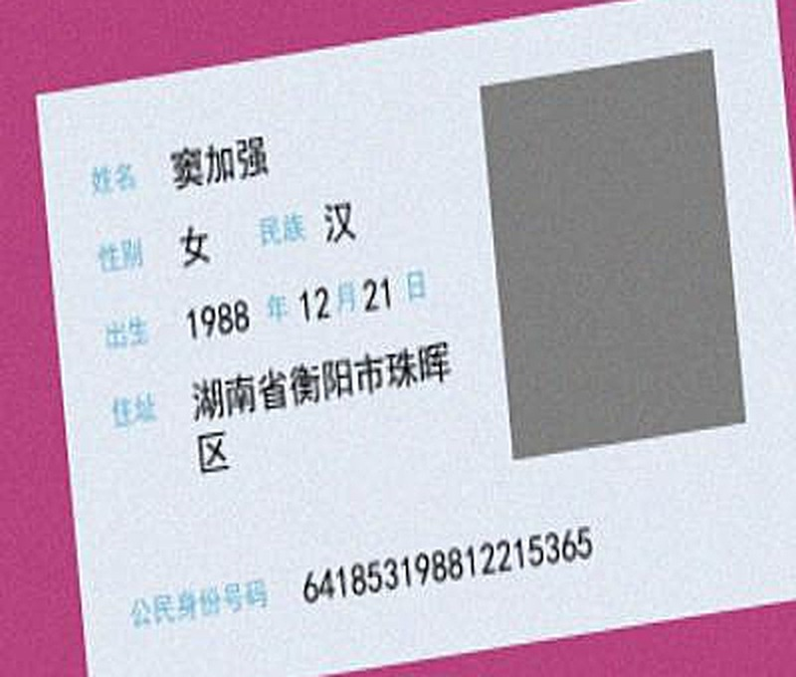
ID CARD PROCESSING (ICP) PIPELINE · MILESTONE 1
Image enhancement
The first stage optionally applies an enhancement operation: brightness, contrast, or sharpening.
None (original)
Brightness +20
Increases every pixel by 20 pixel-value units
Contrast × 1.2
Scales pixel values around mid-gray by a factor of 1.2
Sharpen 1.0
Unsharp mask with a sharpening amount of 1.0
Pixels unchanged
The baseline every other recipe is compared with.
A configuration can contain multiple enhancements, applied in the specified order.

Slide 7
ID CARD PROCESSING (ICP) PIPELINE · MILESTONE 1
OCR engines
We do not train OCR models. We use two well-established engines, EasyOCR and Tesseract
 | Tesseract | EasyOCR
How it reads | Splits the page into text lines, then reads each line | Detects text regions, then reads each region
Languages | Simplified Chinese + English | Simplified Chinese + English
Hardware | CPU only | CPU or GPU
Output | Text, bounding box, confidence | Text, bounding box, confidence
Tesseract's confidence values are divided by 100 so both engines' reported values lie between 0 and 1. Tesseract reports confidence from 0 to 100 and EasyOCR from 0 to 1, so a Tesseract value of 91 becomes 0.91
 | Tesseract | EasyOCR
Python library | pytesseract | easyocr (built on PyTorch)
Model loading | Called once per image | Loaded once, reused for all images
How we ran the full dataset | 40 CPU processes | One GPU
Full run time (8 configurations) | 1.4 hours | 6.2 hours

Slide 8
ID CARD PROCESSING (ICP) PIPELINE · MILESTONE 1
Pipeline configurations
We specify eight image-processing choices, each paired with both OCR engines, giving 16 configurations.
# | Image processing | Stage 1: enhancement | Stage 2: channels
1 | original | None | All three
2 | red | None | Red
3 | green | None | Green
4 | blue | None | Blue
5 | bright + red | Brightness +20 | Red
6 | contrast + red/green | Contrast × 1.2 | Red + green
7 | sharpen + blue | Sharpen 1.0 | Blue
8 | bright + contrast | Brightness +20, then contrast × 1.2 | All three
HOW MANY ARE POSSIBLE?
Stage 1: 4 options (none, brightness, contrast, sharpen)
Stage 2: 7 options (original, 3 single channels, 3 pairs)
Stage 3: 2 engines
4 × 7 × 2 = 56 configurations
WHAT WE RAN
8 image-processing choices × 2 engines = 16 configurations
16 configurations × 20,000 images = 320,000 pipeline runs
More configurations can be added by adding entries to the configuration file

Slide 9
ID CARD PROCESSING (ICP) PIPELINE · MILESTONE 1
Metrics we use have: some lenient and some strict measurements
1. Text recall
2. Location recall
3. Exact field match
Was the value read at all?
Was it found in the right place?
Right place and exactly the right text?
OCR output
窦加强
Annotated box
Label 窦加强
女 汉
OCR box
✓
1988 12 21
overlap
OCR 窦加强
641853198812215365
Passes when the annotated value appears anywhere in the combined OCR text
Passes when the two boxes overlap enough (IoU of at least 0.3).
Passes when the field is located and the text is identical.
Example: birth month 12
PASS:- "12" also appears inside the ID number
FAIL:- no box was found on the month
FAIL :- not located, so it cannot match
Recall = fields that pass ÷ N, where N = 160,000 annotated fields (20,000 cards × 8 fields)
The report writes each metric as a recall, R = N_pass / N, so "Recall" is more accurate than "Score"

Slide 10
ID CARD PROCESSING (ICP) PIPELINE · MILESTONE 1
Speeding up Tesseract and EasyOCR
TESSERACT
EASYOCR
40 parallel processes
One GPU
Tesseract cannot use a GPU and reads one image at a time. We split the work across 40 CPU processes using Python's multiprocessing.Pool.
EasyOCR runs on the GPU because the CPU runs are very slow. The model is loaded once and reused for every image.
Projected · one process
Projected · CPU
~14.2 h
~19.3 h
Measured · 40 processes
Measured · GPU
1.4 h
6.2 h
Throughput | 3 → 26 to 40 images per second
Speedup | 8.2× to 11.1×
Throughput | 1 to 3 → 6.5 to 8.5 images per second
Speedup | 2.3× to 2.6× for six of eight recipes
All 16 configurations finished in 7.6 hours: 1.4 hours for Tesseract and 6.2 hours for EasyOCR.

Slide 11
ID CARD PROCESSING (ICP) PIPELINE · MILESTONE 1
Results: text recall for each configuration
TEXT RECALL BY IMAGE PROCESSING, 20,000 IMAGES
The engine matters most
  EasyOCR is 19 to 27 points higher than Tesseract on every configuration.
Image processing matters less
  Text recall changes by at most 3 points for EasyOCR and 4 points for Tesseract.
Text recall alone is not enough
  Red-channel EasyOCR has the highest text recall (0.758), but its exact field match is 0.305, compared with 0.492 for the blue channel.
Text recall = share of 160,000 labeled fields whose value appears in the OCR output

Slide 12
ID CARD PROCESSING (ICP) PIPELINE · MILESTONE 1
All 16 configurations: accuracy and latency
EASYOCR
TESSERACT
Image processing | Text | Location | Exact | Conf. | s/image
Original | 0.754 | 0.693 | 0.346 | 0.377 | 0.142
Red | 0.758 | 0.702 | 0.305 | 0.334 | 0.151
Green | 0.749 | 0.766 | 0.430 | 0.451 | 0.128
Blue | 0.746 | 0.805 | 0.492 | 0.539 | 0.118
Bright red | 0.751 | 0.699 | 0.302 | 0.332 | 0.154
Contrast red+green | 0.757 | 0.671 | 0.320 | 0.365 | 0.152
Sharpen blue | 0.727 | 0.792 | 0.466 | 0.512 | 0.121
Bright+contrast original | 0.738 | 0.717 | 0.365 | 0.421 | 0.146
Image processing | Text | Location | Exact | Conf. | s/image
Original | 0.523 | 0.681 | 0.243 | 0.591 | 0.034
Red | 0.491 | 0.644 | 0.225 | 0.585 | 0.038
Green | 0.513 | 0.638 | 0.272 | 0.637 | 0.026
Blue | 0.524 | 0.650 | 0.303 | 0.663 | 0.025
Bright red | 0.494 | 0.638 | 0.224 | 0.583 | 0.039
Contrast red+green | 0.516 | 0.665 | 0.241 | 0.588 | 0.035
Sharpen blue | 0.535 | 0.694 | 0.310 | 0.636 | 0.030
Bright+contrast original | 0.529 | 0.671 | 0.263 | 0.599 | 0.032
Text, Location, Exact: recall on 160,000 annotated fields (higher is better).
Shaded row: highest exact field match for that engine.
Conf.: mean OCR confidence. It is each engine's own estimate, not a measure of correctness.
s/image: EasyOCR on GPU. Tesseract's value is total run time divided by images across 40 CPU processes, so it reflects throughput

Slide 13
ID CARD PROCESSING (ICP) PIPELINE · MILESTONE 1
Results by field
EasyOCR, blue channel: recall for each field
Long fields are located but misread
  Address and name are located on at least 99% of cards, but their exact field match is only 27% and 46%.
Text recall overstates short fields
  Birth month and day have a text recall of at least 0.97, yet they are located on only 39% and 60% of cards. A short value may match by chance.
Tesseract shows the same pattern
  Sharpened-blue Tesseract locates the address on 88% of cards, with an exact field match below 1%.

Slide 14
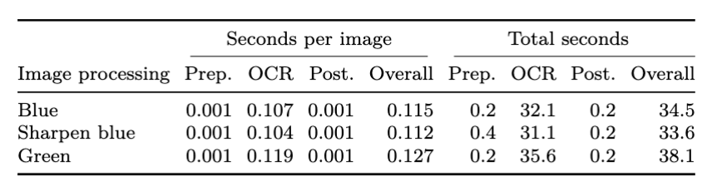
ID CARD PROCESSING (ICP) PIPELINE · MILESTONE 1
14 / 16
The OCR model is the bottleneck and sets the pace for the pipeline
In a separate analysis, each stage was timed and separated into pre-processing (enhancement + channel selection), OCR, post-processing (boilerplate from aggregating the results).
OCR is the most time-consuming stage, this seems to be the case with or without GPU and with or without multiprocessing for
Tesseract
Table: 300-images subset pipeline run timing. We can see that out of 34.5 seconds for the Blue EasyOCR
pipeline, 32.1 seconds were spent on OCR – 93%!
Image processing | Pre-processing | OCR | Post-processing | Other (data loading, loop)
Blue | 0.6% | 93.0% | 0.6% | 5.8%
Sharpen blue | 1.2% | 92.6% | 0.6% | 5.7%
Green | 0.5% | 93.4% | 0.5% | 5.5%
Share of total time spent in each stage, computed from the total seconds above. OCR takes about 93% in all three configurations, while enhancement and channel selection take about 1%. "Other" is the time outside the three stages, such as loading each image

Slide 15
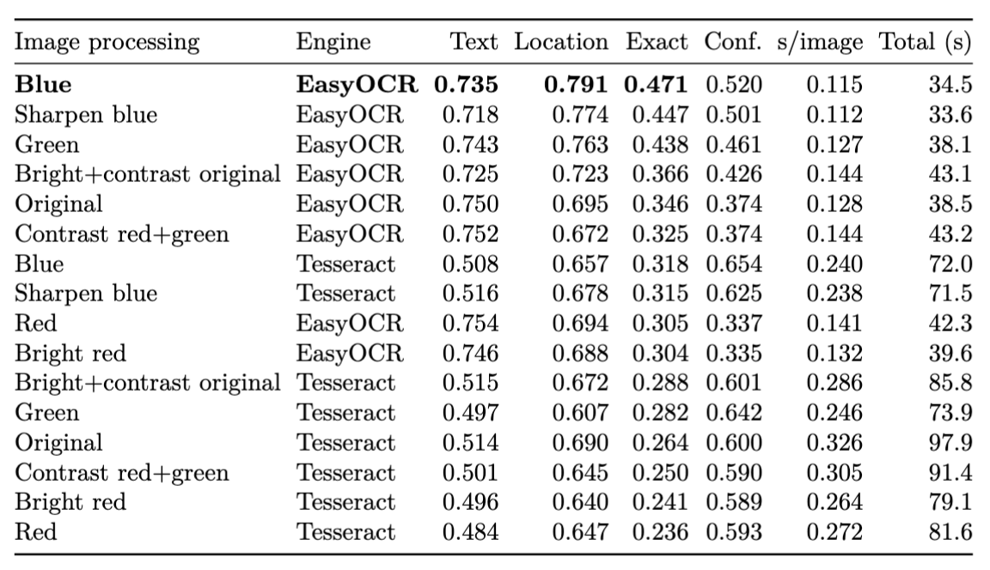
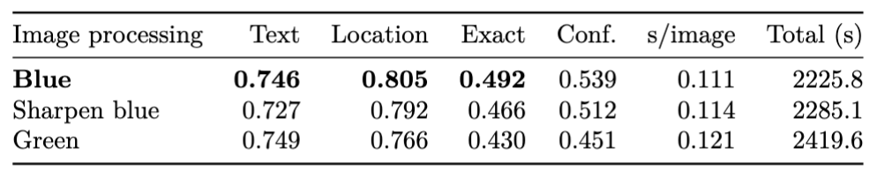
ID CARD PROCESSING (ICP) PIPELINE · MILESTONE 1
14 / 16
Evaluating on smaller set for faster benchmark within some time budget
Evaluate all configurations on a smaller set of images and compute the metrics.
Rank the model by some metric of choice (e.g., exact field measure).
Run the top-k (e.g., top-3) models by that metric on the full set of images.
Table: Results for the top-3 models on the full validation set. Comparing this
The 16 configs on 20k images, we see that we have the same config ranking
Showing that this could be a more efficient benchmark protocol if we just care
about finding the best config in the fastest way
Table: Evaluation of 16 configs on an evaluation set of the same 300 images. Here Tesseract does not use
Multiprocessing. EasyOCR runs on GPU.

Slide 16
ID CARD PROCESSING (ICP) PIPELINE · MILESTONE 1
16 / 16
DEMO TIME!!
The pipeline in action

